Slide 1
CS 218 – DATA STRUCTURES
GRAPHS

Slide 2
Introduction
G= (V,E) //graph representation
Properties
Adjacent
Neighborhood

Slide 3
Representation of graph
Adjacency list
For sparse graphs
Adjacency matrix
For dense graphs

Slide 4
Trees and forests
Tree: If a graph is connected and it contains no cycles, it is called a tree.
Forest: If the graph does not contain any cycles, but is not connected, it is called a forest.
The connected components of a forest are trees

Slide 5
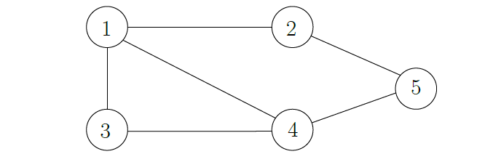
Example

Slide 6
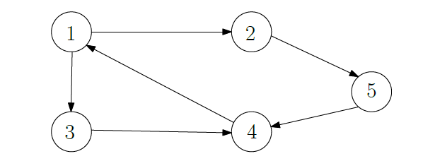
Example

Slide 7
DFS pseudo code
void Graph::dfs( Vertex v ){
v.visited = true;
for each Vertex w adjacent to v
if( !w.visited )
dfs( w );
}

Slide 8
BFS pseudo code
function BFS(s)
visited[1….n] = zeros(n)
todo_queue = [s]
while !isempty(todo_queue) do
v = todo_queue.dequeue()
visited[v] = 1
for all neighbors u of v do
if !visited[u] then
todo_queue.enqueue(u)

Slide 9
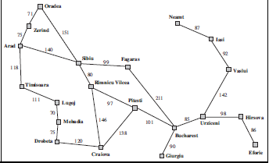
Application of searches: MAP

Slide 10
Shortest path algorithms
Weighted graphs
Dijkstra’s algorithm

Slide 11
Dijkstra’s Introduction
It works for a weighted graph with non-negative weights
builds a shortest-path tree rooted at s
Imp: vertices need to be connected i.e. they should have at least one path between them.

Slide 12
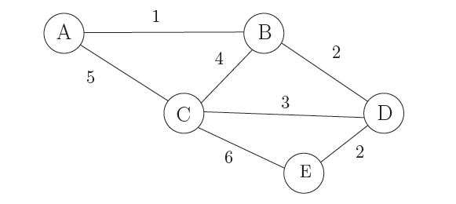
Example

Slide 13
Dijkstra's Algorithm
G = (V, E, W): given weighted graph with set of vertices, edges and edge weights respectively
s: source vertex
d = [] //distance array;
P = [] //parent array
for each vertex v do
d[v] = infinity , P[v] = null, d[s] = 0
R = s ; R’ = V-R
while R != V do
Select edge e = (z, x), where z is part of R, x is part of R’ and d[z] + w(e) is minimum across all such edges
add x to R, remove from R’
set d[x] = d[z] + w(e)
set P[x] = z

Slide 14
Pseudocode (optional - if using discrete structures approach)
DijkstraAlgorithm(weighted simple digraph, vertex first)
for all vertices v
currDist(v) = ∞;
currDist(first) = 0;
toBeChecked = all vertices;
while toBeChecked is !empty
v = a vertex in toBeChecked with minimal currDist(v);
remove v from toBeChecked;
for all vertices u adjacent to v and in toBeChecked
if currDist(u) > currDist(v)+ weight(edge(vu))
currDist(u) = currDist(v)+ weight(edge(vu));
predecessor(u) = v;

Slide 15
Complexity
O(V.E)
Can be modified by incorporating the concept of heap. Use min heap to extract min edge every time. This will take O(log n ) time. Hence the complexity will transform into O((V+E)lg V)
Flaw- wont work with negative edges

Slide 16
MST’s
Problem: Find the cheapest network connecting n nodes.
nodes could be towns (intercity highway connectivity), computers (LANs), servers (Fiber optic network). The network should connect all n nodes (there must be a path between all pairs of nodes).
It should be cheapest least total length of cable, fiber or highways depending on application.

Slide 17
Prim’s algorithm
Input: An undirected weighted graph G = (V,E), Note that unlike Dijkstra weights don't have to be non-negative.
Output: A spanning tree T = (V,E), such that w(T) is minimum among all spanning trees of G.

Slide 18
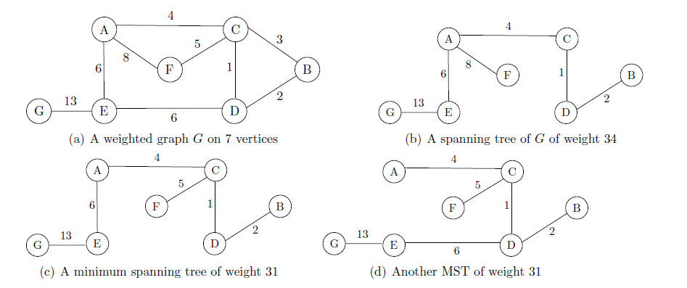

Slide 19
PRIM’S ALGORITHM
R ← s
T ← ∅ ◃ Begin with an empty tree
while R ̸= V do
Select e = (u, v) ∈ E such that w(e) = min (with u in R set and v in R’ set)
T ← T ∪ {e}
R ← R ∪ {v}
//complexity O(E log V) if good sorting algorithm used else O(V^2)

Slide 20
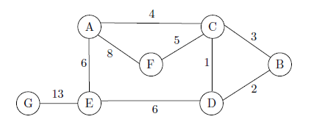
Example

Slide 21
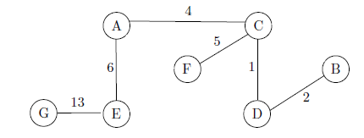
Solution

Slide 22
Kruskal’s algorithm
sort edges in increasing order of weights
F ← ∅
for all edges do
if F ∪ {e} does not contain a cycle then
F ← F ∪ {e}
return F
//complexity O(E log V) if good sorting algorithm used else O(V^2)

Slide 23
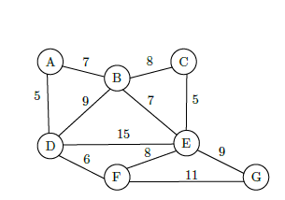
Example

Slide 24
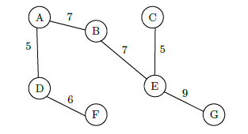
Solution

Slide 25
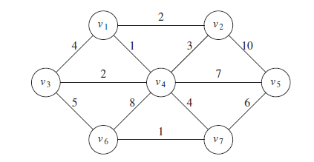
Practice

Slide 26
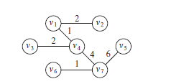
Applying prim’s and kruskal’s

Slide 27
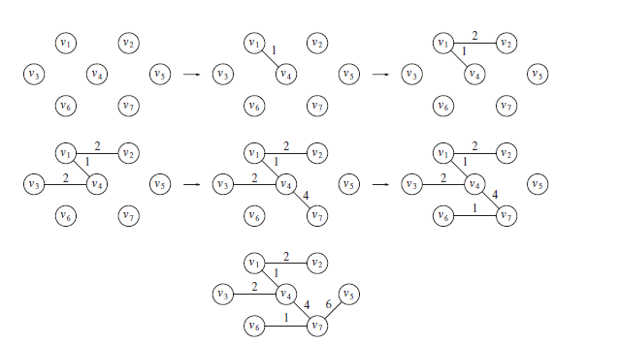
Prims step by step process

Slide 28
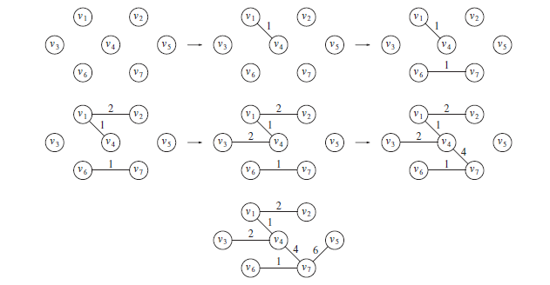
Kruskal’s step by step process

